Slide 1
C The Programming Language Arrays
12th 19th 28th oct

Slide 2
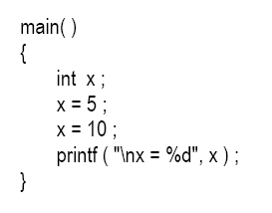
What are Arrays:

Slide 3
Cont’d:
To arrange the percentage marks obtained by 100 students in ascending order.
Construct 100 variables to store percentage marks obtained by 100 different students, i.e. each variable containing one student’s marks.
Construct one variable (called array or subscripted variable) capable of storing or holding all the hundred values.

Slide 4
Arrays:
An array is a collective name given to a group of ‘similar quantities’.
quantities must be ‘similar’.
Each member in the group is referred to by its position in the group. E.g. per = { 48, 88, 34, 23, 96 }
Second member of group: per₂
Fourth member of group: per₄
In C the counting of elements begins with 0 and not with 1.
per[3] refers to 23 and per[4] refers to 96.

Slide 5
Cont’d:
General notation would be per[i]
i can take a value 0, 1, 2, 3, or 4, depending on the position of the element being referred.
per is the subscripted variable (array), whereas i is its subscript .
Similar elements could be all ints, or all floats, or all chars, etc.

Slide 6
Array Program:
Lets try to write a program to find average marks obtained by a class of 30 students in a test.

Slide 7
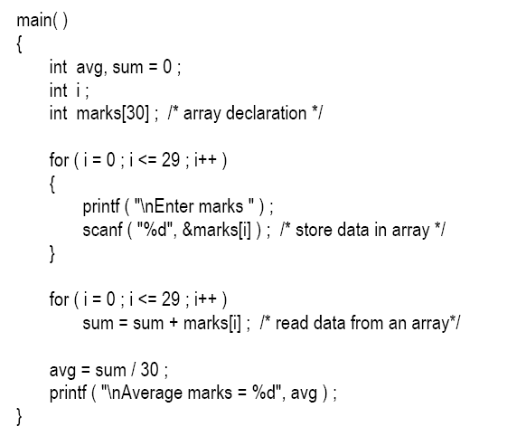

Slide 8
New STUFF:
Array Declaration
Accessing Elements of an Array
Entering Data into an Array
Reading Data from an Array

Slide 9
Array Declaration
like other variables an array needs to be declared so that the compiler will know what kind of an array and how large an array we want.
int marks[30] ;
int specifies the type of the variable,
marks specifies the name of the variable.
The [30]:
30 tells how many elements of the type int will be in our array. ‘dimension’ of the array.
The bracket ( [ ] ) tells the compiler that we are dealing with an array.

Slide 10
Accessing Elements of an Array
let us see how individual elements in the array can be referred.
Subscript, the number in the brackets following the array name.
This number specifies the element’s position in the array. All the array elements are numbered, starting with 0.
Thus, marks[2] is not the second element of the array, but the third.

Slide 11
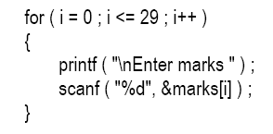
Entering data into Array:

Slide 12
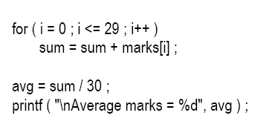
Reading Data From Array:

Slide 13
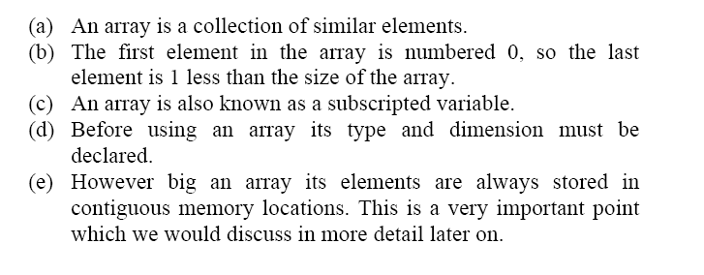
Good Revision:

Slide 14
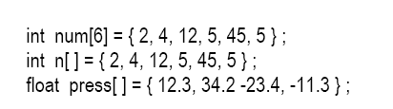
Array Initialisation:

Slide 15
Array Elements in Memory:
Int arr [8]
16 bytes get immediately reserved in memory, 2 bytes each for the 8 integers (under Windows/Linux the array would occupy 32 bytes as each integer would occupy 4 bytes).
And since the array is not being initialized, all eight values present in it would be garbage values.

Slide 16
Cont’d:
This so happens because the storage class of this array is assumed to be auto.
If the storage class is declared to be static then all the array elements would have a default initial value as zero.
Whatever be the initial values, all the array elements would always be present in contiguous memory locations

Slide 17
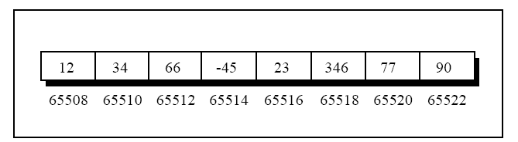
Cont’d:

Slide 18
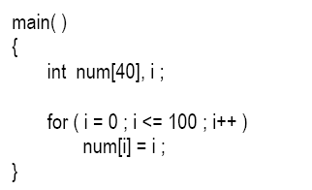

Bounds Checking (suicide)

Slide 19
Pointers:
Pointer is a user defined data type which creates special types of variables which can hold the address of primitive data type like char, int, float, double.
int *ptr;

Slide 20
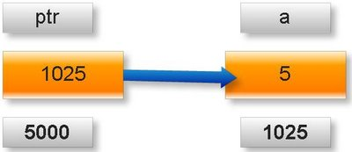
Cont’d:
Meaning of following simple pointer declaration and definition:
int a=5;
int * ptr;
ptr=&a;

Slide 21
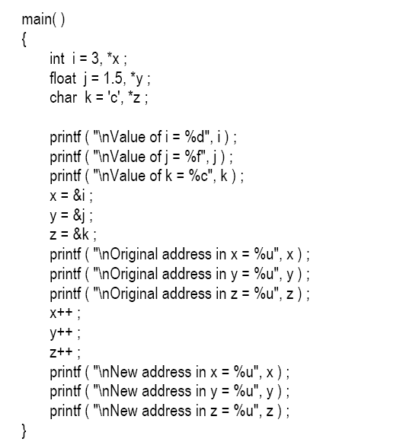

Slide 22
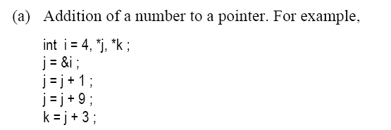

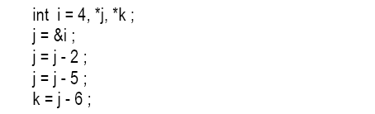
Pointer’s arithmetic:

Slide 23
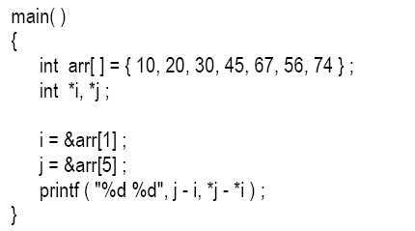
Cont’d:
(c) Subtraction of one pointer from another:
One pointer variable can be subtracted from another provided both variables point to elements of the same array. The resulting value indicates the number of bytes separating the corresponding array elements.

Slide 24
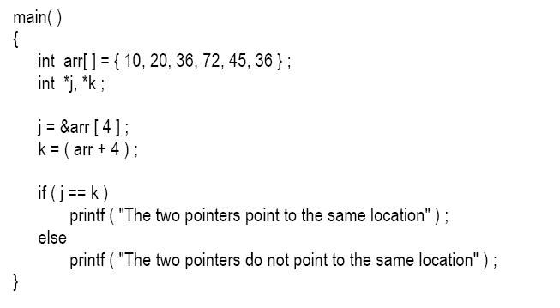
(d) Comparison of two pointer variables:

Slide 25
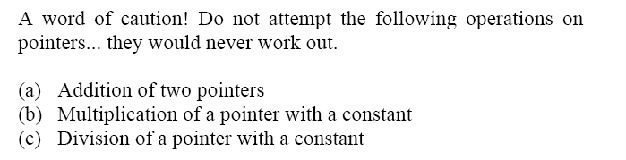

Slide 26
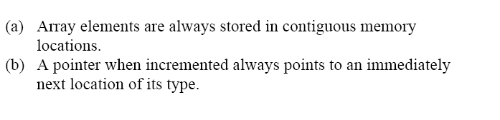

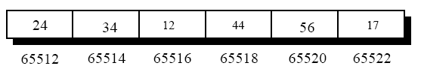

Slide 27
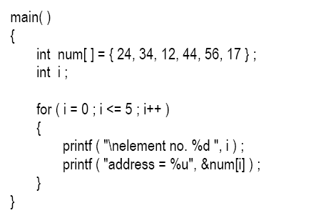
Example:

Slide 28
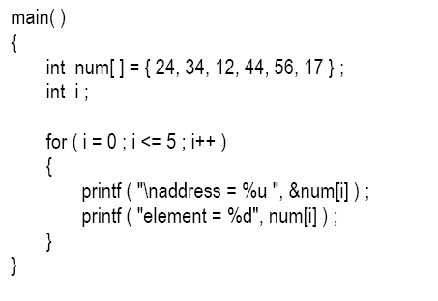
Example 2:

Slide 29
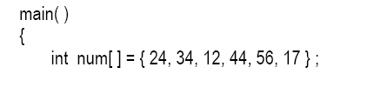
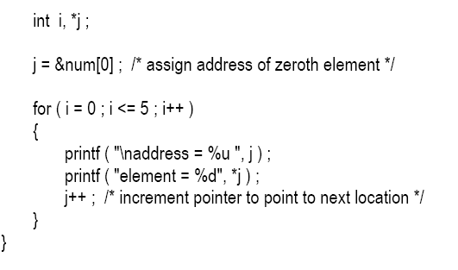

Slide 30
Two Dimensional Arrays:
The two-dimensional array is called as a matrix.
Example:
To store roll number and marks side by side.

Slide 31
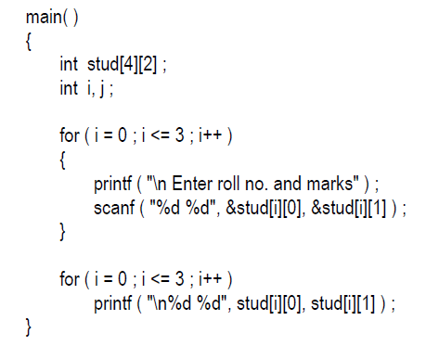

Slide 32
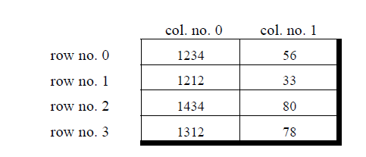

Slide 33
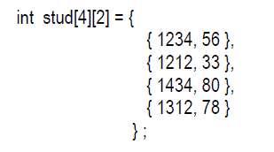
Initializing a Two dimensional Array:

Slide 34
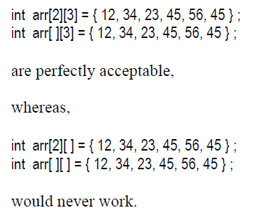
Dimension of a column are a must:

Slide 35
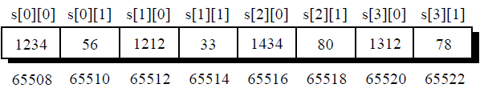
Memory map of 2-D array:

Slide 36
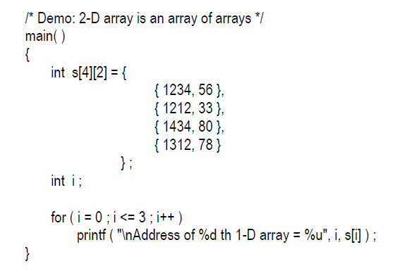
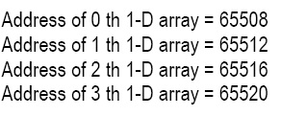

Slide 37
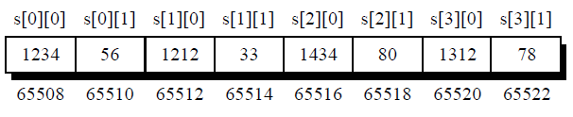

Slide 38
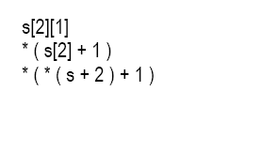
Using Pointers to refer to specific element:

Slide 39
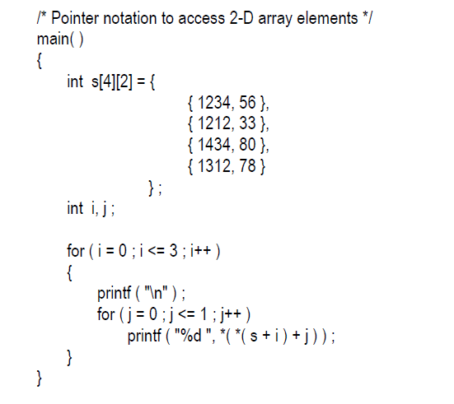

Slide 40
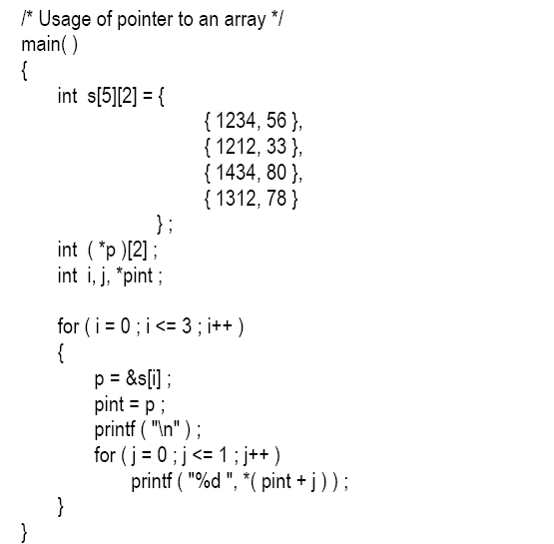
Pointer to an array:

Slide 41
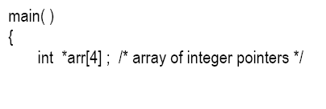
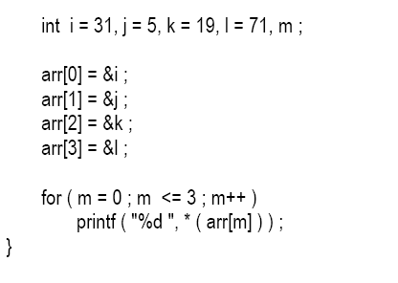
Array Of Pointers:

Slide 42
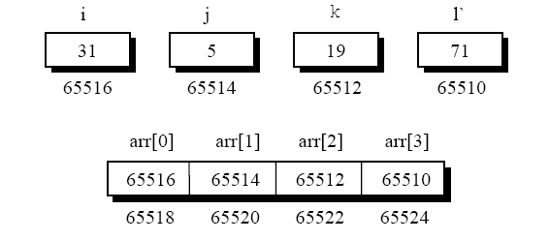
Memory Map:

Slide 43
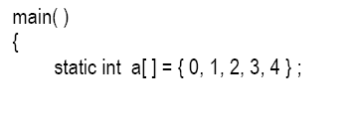
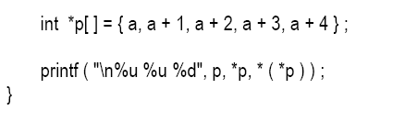
Array of pointers containing addresses of arrays:

Slide 44
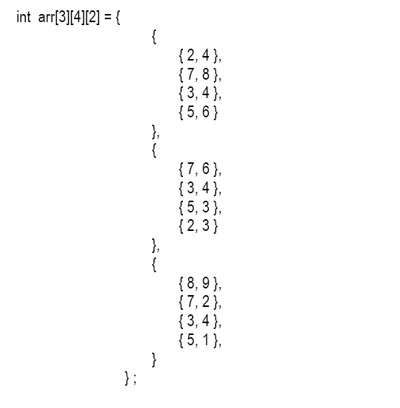
Three Dimensional Array

Slide 45
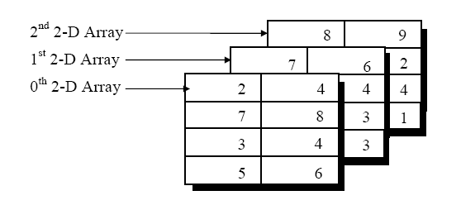
Cont’d:

Slide 46
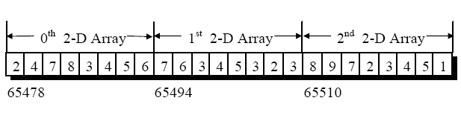
Memory Arrangement

Slide 47

Referring to a specific element of 3-D Array:
Accessing through indexes
Accessing through pointer

Slide 48
End…

